Slide 1
MY JOURNAL TO PYTHON
4110E233 - 高瑞夫

Slide 2
AGENDA
1
LEARNING PYTHON
4
OPERATORS
2
INPUT AND OUTPUT
5
CONTROLS
3
DATA TYPES
6
LOOP
7
FUNCTION

Slide 3
LEARNING PYTHON

Slide 4
CONTENT
Python Introduction
What is Python?
What can Python do?
Why Python?
Good to know
Python Syntax compared to other programming languages
Python Jobs
Why to Learn Python?
Python Online Interpreter
One
Two

Slide 5
CONTENT
Python Syntax
Python Comments
Python Variables
Variable Names
Assign Multiple Values
Output Variables
Global Variables

Slide 6
LEARNING PYTHON
Introduction

Slide 7
What is Python?
Python is a popular programming language. It was created by Guido van Rossum, and released in 1991.
It is used for:
web development (server-side),
software development,
mathematics,
system scripting.

Slide 8
What can Python do?
Python can be used on a server to create web applications.
Python can be used alongside software to create workflows.
Python can connect to database systems. It can also read and modify files.
Python can be used to handle big data and perform complex mathematics.
Python can be used for rapid prototyping, or for production-ready software development.

Slide 9
Why Python?
Python works on different platforms (Windows, Mac, Linux, Raspberry Pi, etc).
Python has a simple syntax similar to the English language.
Python has syntax that allows developers to write programs with fewer lines than some other programming languages.
Python runs on an interpreter system, meaning that code can be executed as soon as it is written. This means that prototyping can be very quick.
Python can be treated in a procedural way, an object-oriented way or a functional way.

Slide 10
Good to know
The most recent major version of Python is Python 3, which we shall be using in this tutorial. However, Python 2, although not being updated with anything other than security updates, is still quite popular.
In this tutorial Python will be written in a text editor. It is possible to write Python in an Integrated Development Environment, such as Thonny, Pycharm, Netbeans or Eclipse which are particularly useful when managing larger collections of Python files.

Slide 11
Python Syntax compared to other programming languages
Python was designed for readability, and has some similarities to the English language with influence from mathematics.
Python uses new lines to complete a command, as opposed to other programming languages which often use semicolons or parentheses.
Python relies on indentation, using whitespace, to define scope; such as the scope of loops, functions and classes. Other programming languages often use curly-brackets for this purpose.

Slide 12
Python Jobs
Python is very high in demand and all the major companies are looking for great Python Programmers to develop websites, software components, and applications or to work with Data Science, AI, and ML technologies.
Today a Python Programmer with 3-5 years of experience is asking for around $150,000 annual package and this is the most demanding programming language in America. Though it can vary depending on the location of the Job. It's impossible to list all of the companies using Python, to name a few big companies are Google, Intel, NASA, PayPal, IBM, and many more...

Slide 13
Why to Learn Python?
Python is consistently rated as one of the world's most popular programming languages. Python is fairly easy to learn, so if you are starting to learn any programming language then Python could be your great choice. Today various Schools, Colleges and Universities are teaching Python as their primary programming language. There are many other good reasons which makes Python as the top choice of any programmer:
Python is Open Source which means its available free of cost.
Python is simple and so easy to learn
Python is versatile and can be used to create many different things.
Python has powerful development libraries include AI, ML etc.
Python is much in demand and ensures high salary

Slide 14
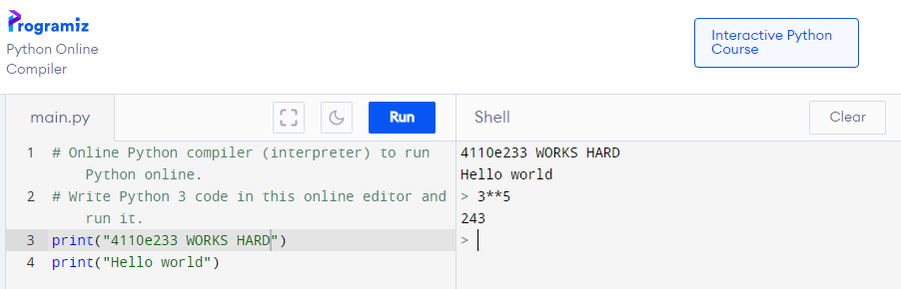
Python Online Interpreter: One

Slide 15
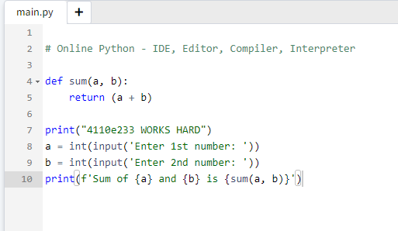
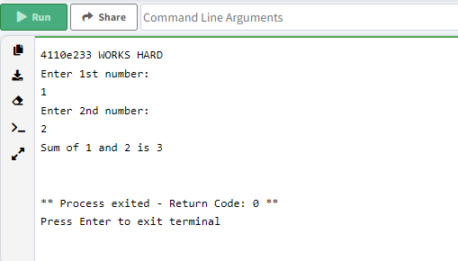
Python Online Interpreter: Two

Slide 16
LEARNING PYTHON
Syntax

Slide 17


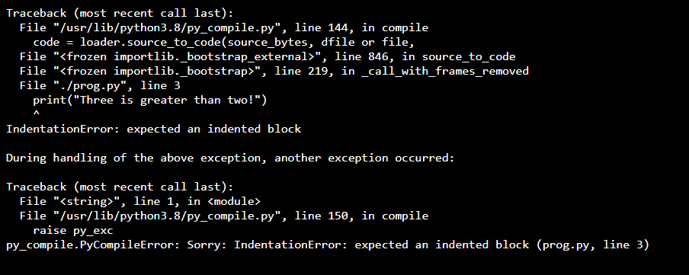

Python Indentation
Indentation refers to the spaces at the beginning of a code line.
Where in other programming languages the indentation in code is for readability only, the indentation in Python is very important.
Python uses indentation to indicate a block of code.
Correct Indentation
Incorrect Indentation

Slide 18
LEARNING PYTHON
Comments

Slide 19



Creating a Comment
Comments starts with a #, and Python will ignore them
Comments can be placed at the end of a line, and Python will ignore the rest of the line:

